Slide 1

SAP Analytics cloud training
Anubhav Oberoy
Day 9

Slide 2
Agenda – Day 9
Value Driver Tree
- VDT
- Type of VDT
- Create from Blank Model
- Design VDT
- Create New Model
---Break---
Data Actions and Collaboration
- Introduction to Data Actions
- Types of data actions
- Copy Data action
- Scripted Data action scenario
- Collaboration
Notes:
Data Actions & Connections Basics
Data Actions in SAC
Introduction to Connections
Cloud Connector
Connecting to Import data with BW
Connecting to S/4HANA System
---Break---
Build CDS Views
Introduction to CDS View
Consume S/4HANA CDS views
Import data connection
Live Data connection with analytic Query

Slide 3

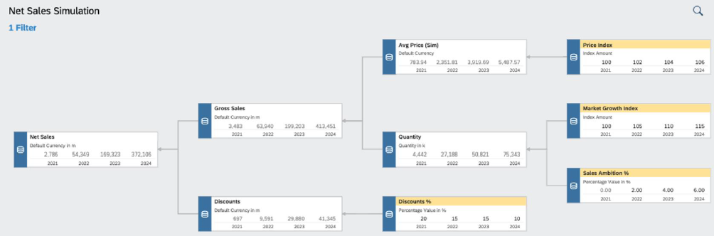
VDT
▪ Value driver trees (VDTs) allow visualizing the composition of a KPI and its contributing factors
▪ A VDT shows how a KPI is calculated from other KPIs and drivers
▪ In SAC, a value driver tree can be used to visualize existing data but also to simulate the impact of driver
changes in real time
▪ In planning, the VDT component can be used to create and simulate different scenarios
▪ Value driver trees are provided as standard story widgets and can be seamlessly integrated into SAC stories
www.anubhavtrainings.com

Slide 4
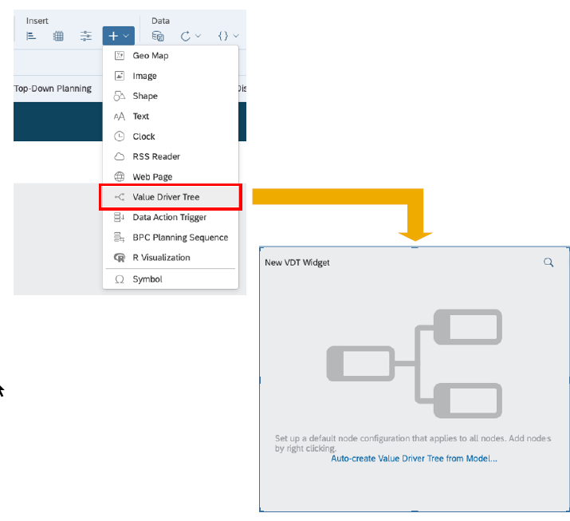
VDT
A value driver tree is a standard widget in the story
▪ VDT widgets can be configured like any other story widget by adding a new component and then using the builder panel
▪ A VDT is based on a data model. The nodes of the tree correspond to KPIs defined in the account dimension
▪ You can automatically generate a value driver tree from an existing model
▪ Alternatively, you can start building the tree from scratch, defining the nodes manually
www.anubhavtrainings.com

Slide 5

Use case 2
We would like observe the impact of market growth, price index, growth rate on our net revenue. VDT is just a representation of account dimensions connected together. All the calculations related to VDT are going to be done inside the MODEL.
Gross Sales = Quantity (~MarketGrowth, ~SalesAmbition) X Price (~PriceIndex)
Net Sales = gross Sales – Discount (~Discount %)
Price
Price Index
Gross Sales
Growth Rate
Quantity
Net Sales
Sales Ambition %
Discount
Discount %
www.anubhavtrainings.com

Slide 6
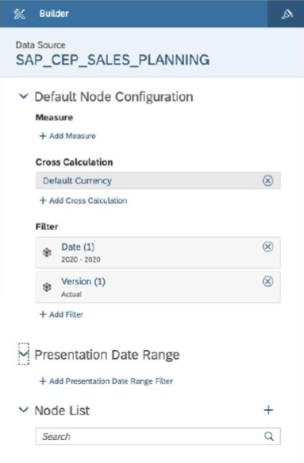
VDT – Node Config
A VDT is built by adding multiple nodes to the Node
List in the builder panel
▪ Each new node will inherit the default node configuration
▪ The configuration can be adjusted for each individual node
▪ The (visual) relation between the nodes is configured via parent/child properties of each node
▪ Parent/child nodes are other existing nodes from the node list
www.anubhavtrainings.com

Slide 7
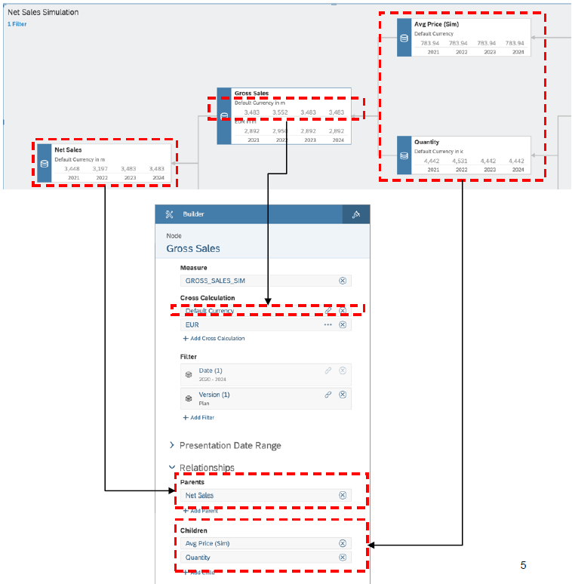
VDT
▪ For each node in the tree, the following parameters
can be configured:
− Measure: KPI to be shown (member of the
account dimension)
− Cross Calculation: Additional measures based
on the base KPI (e.g. different currencies)
− Filter: Scope definition for the KPI
− Presentation Date: Time horizon displayed in
the node
− Relationships: Parent and child nodes in the
tree
www.anubhavtrainings.com

Slide 8
Demo Scenario

Slide 9
Use case 2
We would like observe the impact of market growth, price index, growth rate on our net revenue. VDT is just a representation of account dimensions connected together. All the calculations related to VDT are going to be done inside the MODEL.
Gross Sales = Quantity (~MarketGrowth, ~SalesAmbition) X Price (~PriceIndex)
Net Sales = gross Sales – Discount (~Discount %)
Price
Price Index
Gross Sales
Growth Rate
Quantity
Net Sales
Sales Ambition %
Discount
Discount %
www.anubhavtrainings.com

Slide 10
VDT – Node Config
A VDT is built by adding multiple nodes to the Node
List in the builder panel
▪ Each new node will inherit the default node configuration
▪ The configuration can be adjusted for each individual node
▪ The (visual) relation between the nodes is configured via parent/child properties of each node
▪ Parent/child nodes are other existing nodes from the node list
www.anubhavtrainings.com

Slide 11
VDT
▪ For each node in the tree, the following parameters
can be configured:
− Measure: KPI to be shown (member of the
account dimension)
− Cross Calculation: Additional measures based
on the base KPI (e.g. different currencies)
− Filter: Scope definition for the KPI
− Presentation Date: Time horizon displayed in
the node
− Relationships: Parent and child nodes in the
tree
www.anubhavtrainings.com

Slide 12
New Model
Classic Model New Model
We have only one measure which is an account measure, that contains all the values combining together.
We cannot add calculated measure while building this model.
The account dimension concept resembles from old BI tools.
Data mapping is old style and tell about the errors only at the final creation steps.
A default measure with name called value gets created.
We can have individual measures along with account dimension also. While building the model, based on preference, we can choose structural priority.
We can add a calculated measure while building the model.
We can develop model which look exactly same as database table in your source system.
We use a enhanced mapping tool which will show a guided flow and unearthed the errors in early phase.
The name of the measure will be same name as column name from the source.
The main purpose is to avoid confusion related to the account dimension in data model for layman.
www.anubhavtrainings.com

Slide 13
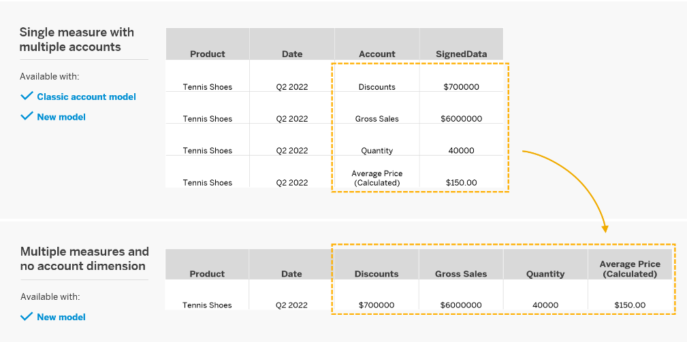
New Model

Slide 14
Data Actions
Used for automating work in SAC planning. They helps end users/planning experts to perform complex tasks with the click of a button.
e.g. if we would like to distribute, allocate, copy, calculate data in planning model, the user needs to do that manually by changing values in report, or needs to have deep understanding of SAC.
You as SAC planning consultant can automate this work with data actions. End user, will just click on a button and the work will be done.
https://help.sap.com/viewer/00f68c2e08b941f081002fd3691d86a7/release/en-US/afe93e3cf1414a7b8419baad11cc066e.html#loioafe93e3cf1414a7b8419baad11cc066e__data_resultlookup
www.anubhavtrainings.com

Slide 15
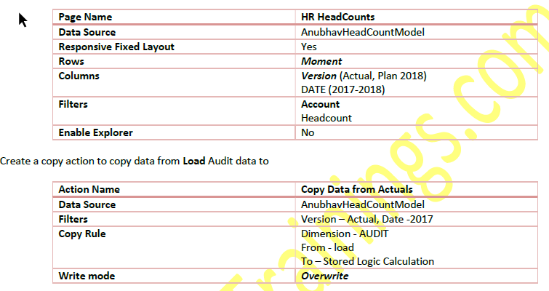
Requirement 1: Copy Data Action
Create Story action to copy the data of 2017 headcount to 2018 plan version
www.anubhavtrainings.com

Slide 16
Requirement 2: Auto calculate headcounts based on Scripting based actions
Finally, we would like to calculate the headcounts based on Hires and Terminations. For calculation, we have to set the opening balance to the ending balance of previous period and Add new hires and subtract the terminations to calculate the final balance. These set of actions needs to be repeated for entire duration on MoM basis.
This is performed using the scripting-based actions, for the ease of writing Anubhav will also show Visual way of writing the script.
CONFIG.TIME_HIERARCHY = CALENDARYEAR
CONFIG.FLIPPING_SIGN_ACCORDING_ACCTYPE = OFF
CONFIG.GENERATE_UNBOOKED_DATA = OFF
MEMBERSET [d/Date] = (BASEMEMBER([d/Date].[h/YQM], "2018"))
FOREACH [d/Date]
DATA([d/MOMENT] = "OPENING") = RESULTLOOKUP([d/MOMENT] = "CLOSING", [d/Date] =
Previous(1))
DATA([d/MOMENT] = "CLOSING") = RESULTLOOKUP([d/MOMENT] = "OPENING") +
RESULTLOOKUP([d/MOMENT] = "HIRES") - RESULTLOOKUP([d/MOMENT] = "TERMINATIONS")
ENDFOR
www.anubhavtrainings.com

Slide 17
What are all the challenges for CEO of a co?
Insight with a simple click
Taking decisions
Planning for future
Real-time information
Resource management
Different perspective at same time
Transparency
Fin
S/4HANA
Procure
Ariba
HR
SuccessFactors
Sales
Hybris Sales Cloud
Marketing
Sales Force
Travel
Concur
www.anubhavtrainings.com

Slide 18
Collaboration
Calendar
Comments
Share
www.anubhavtrainings.com

Slide 19
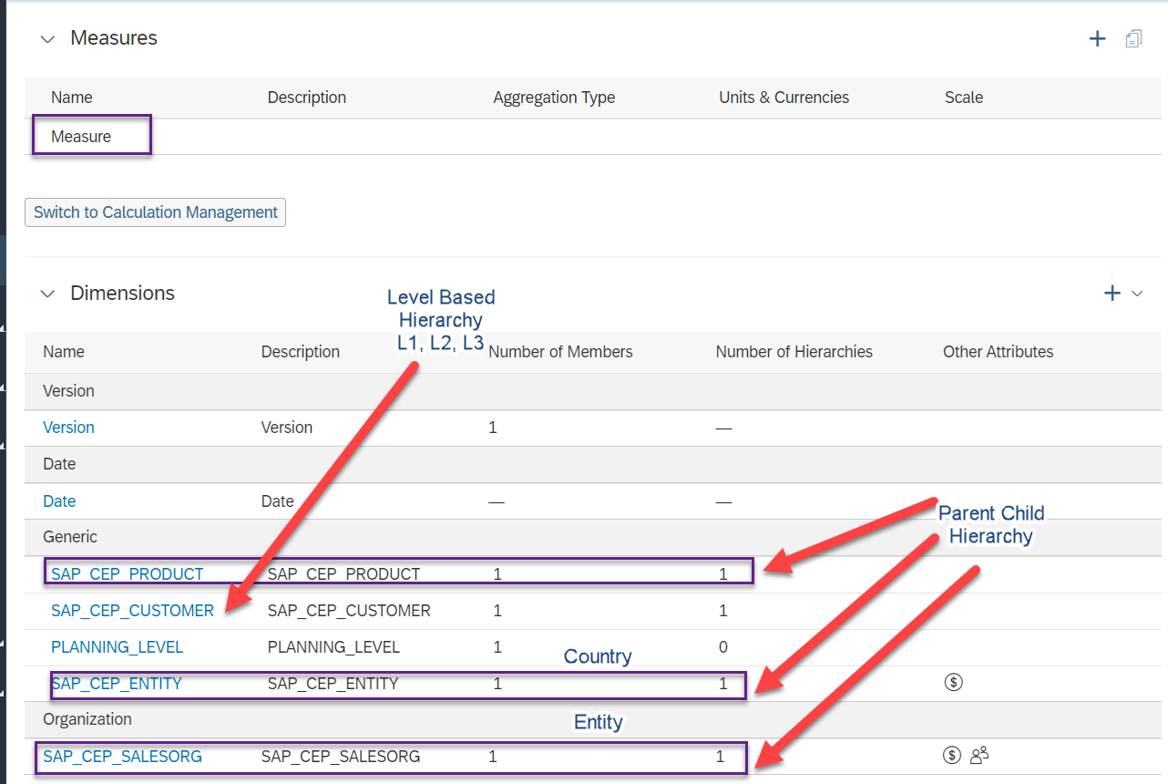

Slide 20
Use case 2
We would like observe the impact of market growth, price index, growth rate on our net revenue. VDT is just a representation of account dimensions connected together. All the calculations related to VDT are going to be done inside the MODEL.
Gross Sales = Quantity (~MarketGrowth, ~SalesAmbition) X Price (~PriceIndex)
Net Sales = gross Sales – Discount (~Discount %)
Price
Price Index
Gross Sales
Growth Rate
Quantity
Net Sales
Sales Ambition %
Discount
Discount %
www.anubhavtrainings.com

Slide 21
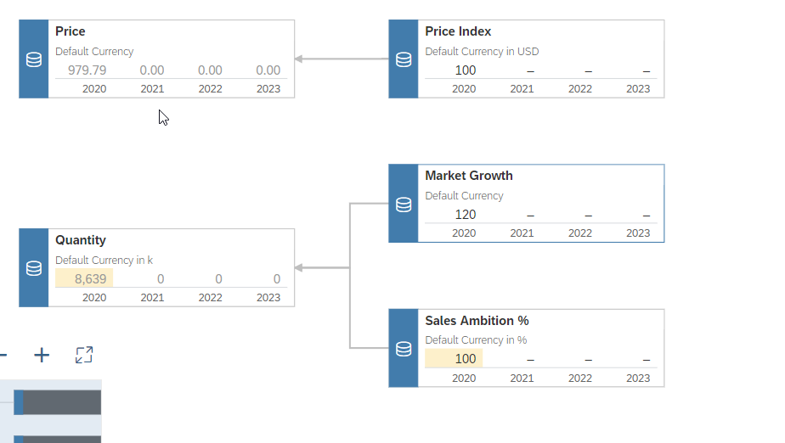
Avg. Price
Price Index
Market Growth Index
Quantity (Sim)
Sales Ambition %

Slide 22
VDT – Node Config
A VDT is built by adding multiple nodes to the Node
List in the builder panel
▪ Each new node will inherit the default node configuration
▪ The configuration can be adjusted for each individual node
▪ The (visual) relation between the nodes is configured via parent/child properties of each node
▪ Parent/child nodes are other existing nodes from the node list
www.anubhavtrainings.com

Slide 23
VDT
▪ For each node in the tree, the following parameters
can be configured:
− Measure: KPI to be shown (member of the
account dimension)
− Cross Calculation: Additional measures based
on the base KPI (e.g. different currencies)
− Filter: Scope definition for the KPI
− Presentation Date: Time horizon displayed in
the node
− Relationships: Parent and child nodes in the
tree
www.anubhavtrainings.com

Slide 24
New Model
Classic Model New Model
We have only one measure which is an account measure, that contains all the values combining together.
We cannot add calculated measure while building this model.
The account dimension concept resembles from old BI tools.
Data mapping is old style and tell about the errors only at the final creation steps.
A default measure with name called value gets created.
We can have individual measures along with account dimension also. While building the model, based on preference, we can choose structural priority.
We can add a calculated measure while building the model.
We can develop model which look exactly same as database table in your source system.
We use a enhanced mapping tool which will show a guided flow and unearthed the errors in early phase.
The name of the measure will be same name as column name from the source.
The main purpose is to avoid confusion related to the account dimension in data model for layman.
www.anubhavtrainings.com

Slide 25
New Model

Slide 26
Data Actions
Used for automating work in SAC planning. They helps end users/planning experts to perform complex tasks with the click of a button.
e.g. if we would like to distribute, allocate, copy, calculate data in planning model, the user needs to do that manually by changing values in report, or needs to have deep understanding of SAC.
You as SAC planning consultant can automate this work with data actions. End user, will just click on a button and the work will be done.
https://help.sap.com/viewer/00f68c2e08b941f081002fd3691d86a7/release/en-US/afe93e3cf1414a7b8419baad11cc066e.html#loioafe93e3cf1414a7b8419baad11cc066e__data_resultlookup
www.anubhavtrainings.com

Slide 27
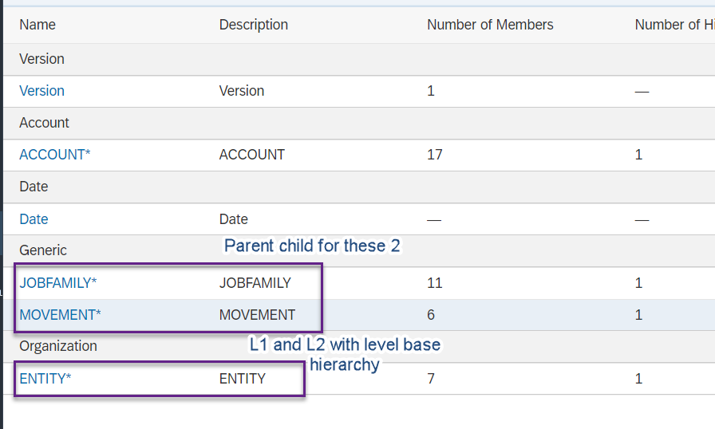

Slide 28
Requirement 1: Copy Data Action
Create Story action to copy the data of 2017 headcount to 2018 plan version
www.anubhavtrainings.com

Slide 29
Requirement 2: Auto calculate headcounts based on Scripting based actions
Finally, we would like to calculate the headcounts based on Hires and Terminations. For calculation, we have to set the opening balance to the ending balance of previous period and Add new hires and subtract the terminations to calculate the final balance. These set of actions needs to be repeated for entire duration on MoM basis.
This is performed using the scripting-based actions, for the ease of writing Anubhav will also show Visual way of writing the script.
CONFIG.TIME_HIERARCHY = CALENDARYEAR
CONFIG.FLIPPING_SIGN_ACCORDING_ACCTYPE = OFF
CONFIG.GENERATE_UNBOOKED_DATA = OFF
MEMBERSET [d/Date] = (BASEMEMBER([d/Date].[h/YQM], "2018"))
FOREACH [d/Date]
DATA([d/MOMENT] = "OPENING") = RESULTLOOKUP([d/MOMENT] = "CLOSING", [d/Date] =
Previous(1))
DATA([d/MOMENT] = "CLOSING") = RESULTLOOKUP([d/MOMENT] = "OPENING") +
RESULTLOOKUP([d/MOMENT] = "HIRES") - RESULTLOOKUP([d/MOMENT] = "TERMINATIONS")
ENDFOR
www.anubhavtrainings.com

Slide 30
What are all the challenges for CEO of a co?
Insight with a simple click
Taking decisions
Planning for future
Real-time information
Resource management
Different perspective at same time
Transparency
Fin
S/4HANA
Procure
Ariba
HR
SuccessFactors
Sales
Hybris Sales Cloud
Marketing
Sales Force
Travel
Concur
www.anubhavtrainings.com

Slide 31
Collaboration
Calendar
Comments
Share
www.anubhavtrainings.com

Slide 32
Requirement 1: Copy Data Action
Create Story action to copy the data of 2017 headcount to 2018 plan version
www.anubhavtrainings.com

Slide 33


Slide 34
Requirement 2: Auto calculate headcounts based on Scripting based actions
Finally, we would like to calculate the headcounts based on Hires and Terminations. For calculation, we have to set the opening balance to the ending balance of previous period and Add new hires and subtract the terminations to calculate the final balance. These set of actions needs to be repeated for entire duration on MoM basis.
This is performed using the scripting-based actions, for the ease of writing Anubhav will also show Visual way of writing the script.
CONFIG.TIME_HIERARCHY = CALENDARYEAR
CONFIG.FLIPPING_SIGN_ACCORDING_ACCTYPE = OFF
CONFIG.GENERATE_UNBOOKED_DATA = OFF
MEMBERSET [d/Date] = (BASEMEMBER([d/Date].[h/YQM], "2018"))
FOREACH [d/Date]
DATA([d/MOMENT] = "OPENING") = RESULTLOOKUP([d/MOMENT] = "CLOSING", [d/Date] =
Previous(1))
DATA([d/MOMENT] = "CLOSING") = RESULTLOOKUP([d/MOMENT] = "OPENING") +
RESULTLOOKUP([d/MOMENT] = "HIRES") - RESULTLOOKUP([d/MOMENT] = "TERMINATIONS")
ENDFOR
www.anubhavtrainings.com

Slide 35
What are all the challenges for CEO of a co?
Insight with a simple click
Taking decisions
Planning for future
Real-time information
Resource management
Different perspective at same time
Transparency
Fin
S/4HANA
Procure
Ariba
HR
SuccessFactors
Sales
Hybris Sales Cloud
Marketing
Sales Force
Travel
Concur
www.anubhavtrainings.com

Slide 36
Collaboration
Calendar
Comments
Share
www.anubhavtrainings.com

Slide 37
Real SAC system Access
Acquired Data Connection
Connect to real time system only once, and pull all the data into SAC.
Data is stored inside SAC securely, Data security is subjected to SAC
Data needs to updated timely manner, you can schedule auto-updates.
All features can be accessed if its acquired data
e.g. Google drive, S/4HANA Acquired – CDS View
Live Data Connection
Data is never replicated to SAC, it lives in the original system (source system)
Only the skeleton (structure) of the data is represented in SAC Model
All the data transformation and Security is managed by Source System
Data is Real-time and storage cost in SAC is minimal
You can use existing assets like BI Universe, BW Bex Queries, Info providers, CDS views
Performance can go bad at sometime but we can tune
We can perform Close-loop scenario
www.anubhavtrainings.com

Slide 38
Connections
SAP analytic Agent
Public Cloud
Internet
Intranet
Source Systems
BW,BI,S/4H,ABAP,BO,HANA
On premise
SAC
SAP Analytics Cloud System
SAP Cloud Connector
InA
BTP
VPN
PC
S/4HANA, SF
HANA Cloud etc.
Azure, GCP, AWS
InA
Adaptor
www.anubhavtrainings.com

Slide 39
smartpredict-demo.us10.sapanalytics.cloud
SAP SAC Server
Browser
Connection to BW or S/4HANA
CORS Headers to browser
Exception to allow CORS call to me from browser
CORS
Cross Origin Resource Sharing
stcfin.st.com:8021/
S/4HANA
BW
ina
Hey! I am fine if someone make a CORS call to me!

Slide 40
SAP CP

Slide 41
Live data connection
B. Create an Adaptor (BAS)
Template program
Import the adaptor
Settings
Deploy it as webapp
SAC
HANA
Adaptor
C. Create a Live Connection(SAC)
To the adaptor
Build story
A . WebIDE
Develop HANA Tables
Load dummy Data
Create a model – CUBE – Calculation

Slide 42
CORS
https://sactrial-saceu10-f4aajqsq4u7m952hny9vpm8p.eu10.hanacloudservices.cloud.sap/
SAP Analytics Cloud
SCP
Browser
CORS
CORS Headers
SAC system
BW, BI, BO, ECC….
SAP S/4HANA
On Premise
Special permission
ina
http://sts4dev.st.com:8001/sap/bw/ina/getresponse?sap-client=800
www.anubhavtrainings.com

Slide 43
NW versions required to release CORS Headers
Check the system version of your ABAP based system
NW 7.52 SP02
NW 7.51 SP06
NW 7.50 SP13
NW 7.40 SP20
SAP Kernel Version 7.49PL315
2. Check if INA Service is active in the system. TCOODE: SICF and search for INA service
3. The system must be SSH enabled, HTTPS signed certificate (Network admin)- STRUST
4. Inform Our SAP system that we can offer CORS headers RZ10(system wide-need NW restart)
RZ9 (temporary)
Icf/cors_enabled
5. For On-premise systems running in Intranet, you need sap cloud connector
6. Add the settings to issue CORS headers to browser for your SAC system - UCONCOCKPIT
https://help.sap.com/viewer/00f68c2e08b941f081002fd3691d86a7/release/en-US/0d1cd72013804eb78e2aea45a562e439.html?q=uconcockpit
https://blogs.sap.com/2019/03/24/use-cors-for-your-netweaver-backend-connection-to-cloud-analytics/
www.anubhavtrainings.com

Slide 44
SAC
HANA
Calculation View
(data model)
ABAP on HANA training 9th April 2022
Weekend 7-9 IST
SAC
S/4HANA (ERP)
CDS View
(data model)

Slide 45
CDS – Core Data & Services
CDS stands for Core Data & Services, these are the data models in ABAP system which is based out of HANA DB. We have 2 types of CDS
ABAP CDS – ABAP system which runs on HANA
HANA CDS – Do not have ABAP system at all, we have just HANA
These are used to expose data out of system in form of Views.
ABAP on HANA – ADT
Native HANA – HANA WebIDE
With SAP S/4HANA system, There is NO BW system required anymore. SAP delivers 1000s of cds views for ready to use consumption.
www.anubhavtrainings.com

Slide 46
<Title>
Fiori App
BI Tools
Portal
SAC
Consumption Views
Consumption Views
Data Models
Interface Views
Interface Views
Interface Views
Private Views
Private Views
Private Views
Private Views
DB Tables
DB Tables
DB Tables
DB Tables
www.anubhavtrainings.com

Slide 47
Acquire Data Connection
Create a CDS View
Activate
Activate Odata service
Create an Acquire data connection
Pull all data from system and show in a dashboard
Sales

Slide 48
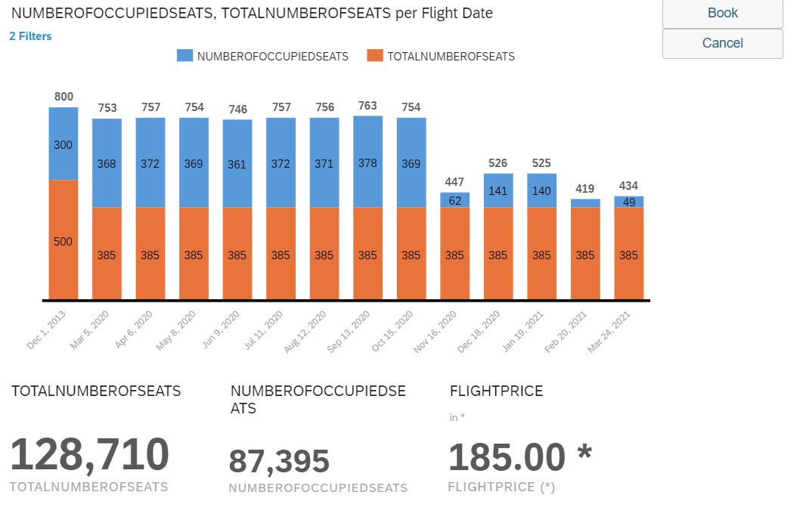
<Title>
www.anubhavtrainings.com

Slide 49
Feedback Link
https://feedbackind.vinsys.com/Indiafeedback.html?batch_id%3D483

Slide 50
End of Day 9

Slide 51

Questions

Slide 52

Anubhav Oberoy
anubhav.abap@gmail.com

